Slide 2
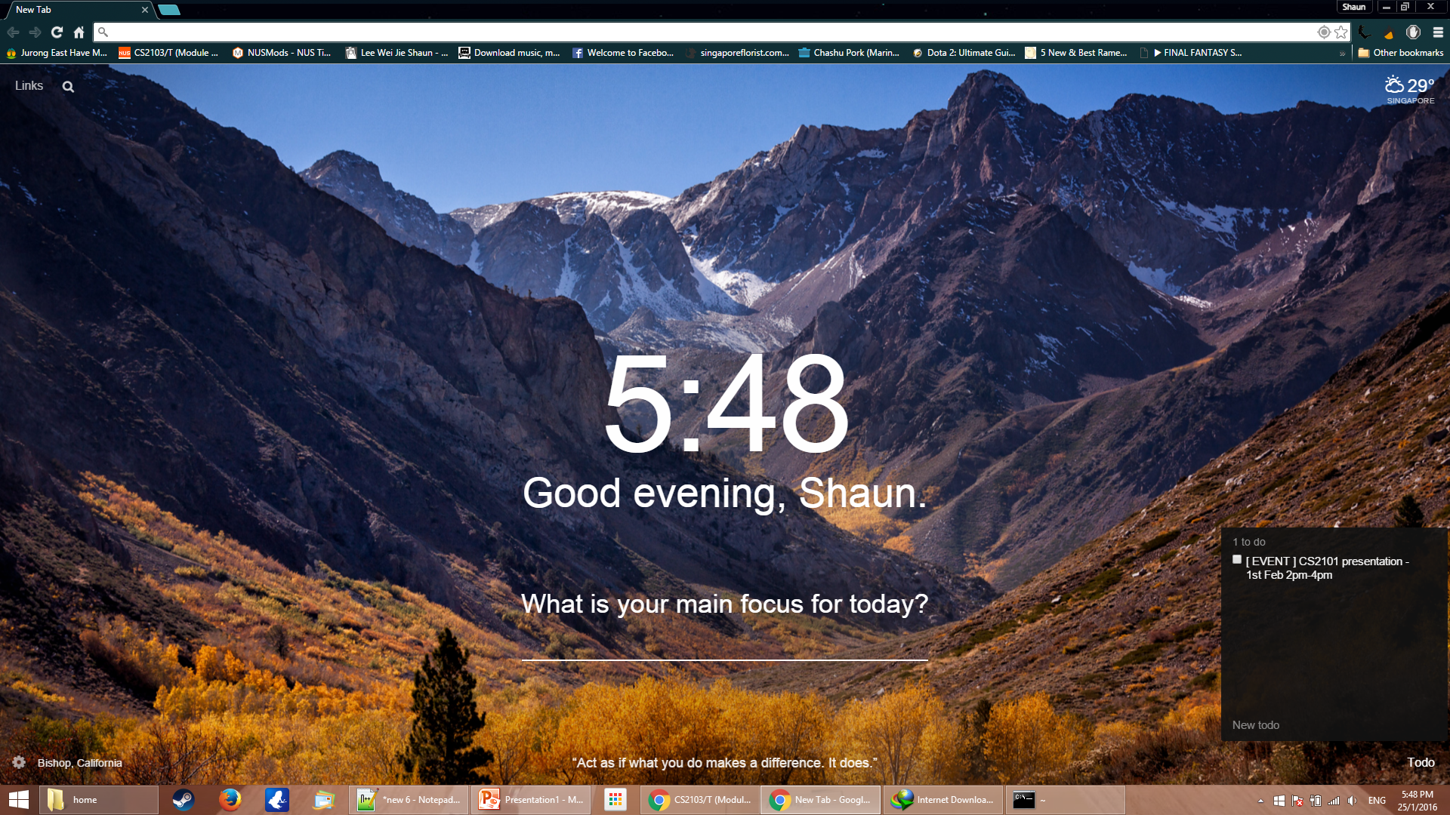
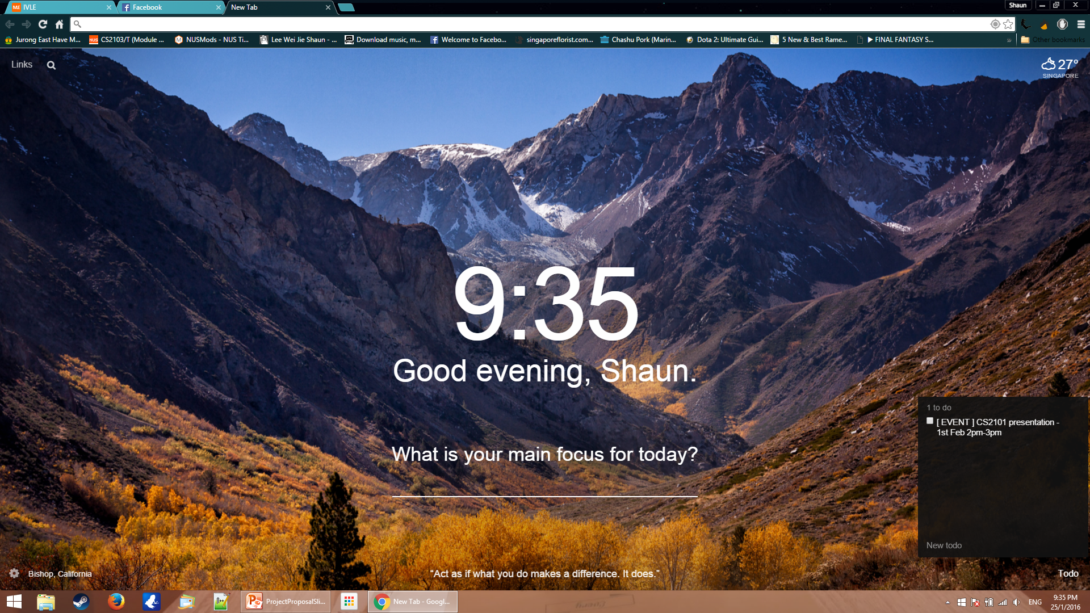
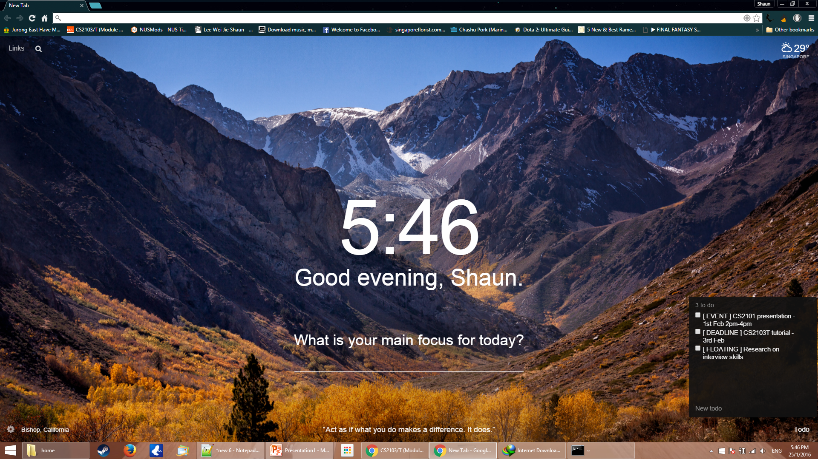
Basic Functionalities
Types of Tasks
Events (time period)
Deadlines
Floating Tasks (no specific)
CRUD
Create
Retrieve
Update
Delete

Slide 3
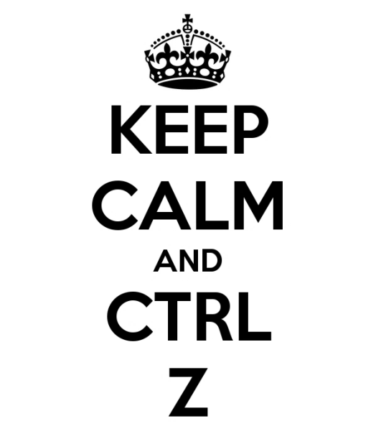
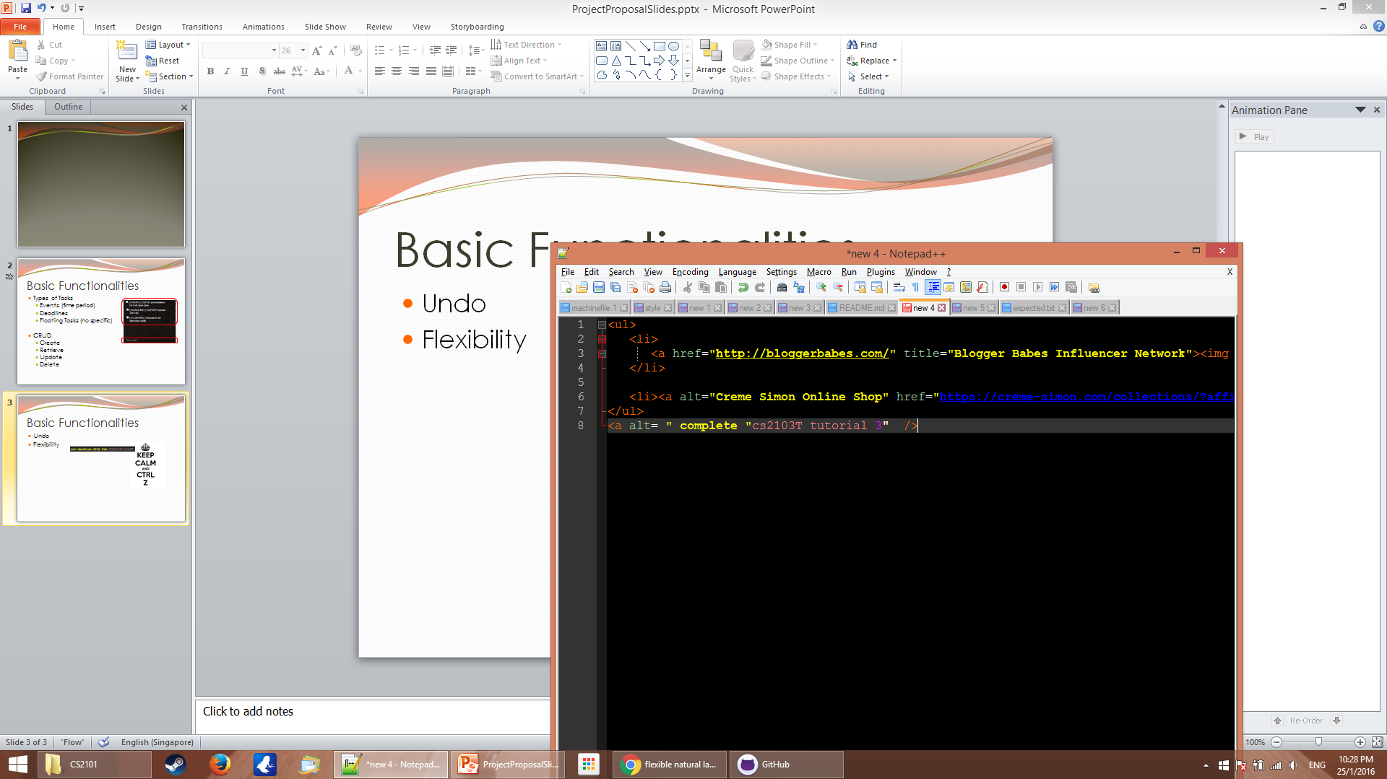
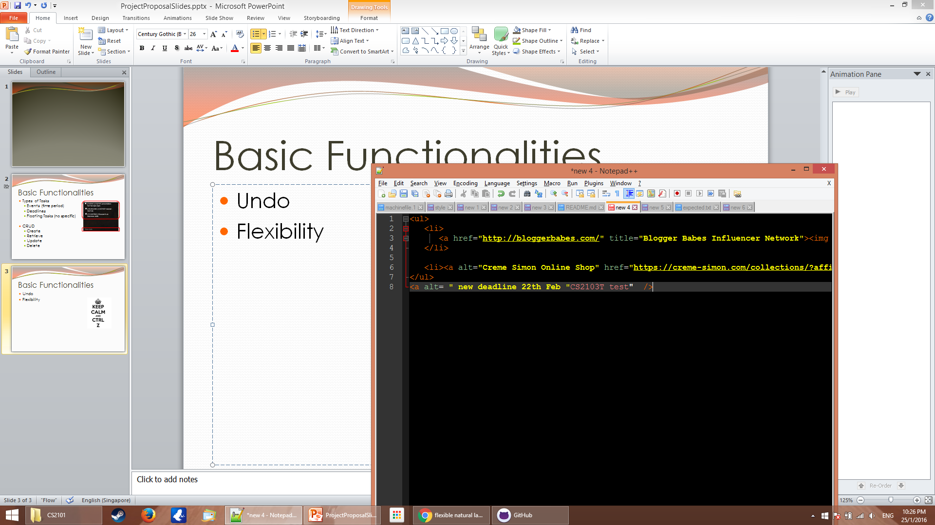
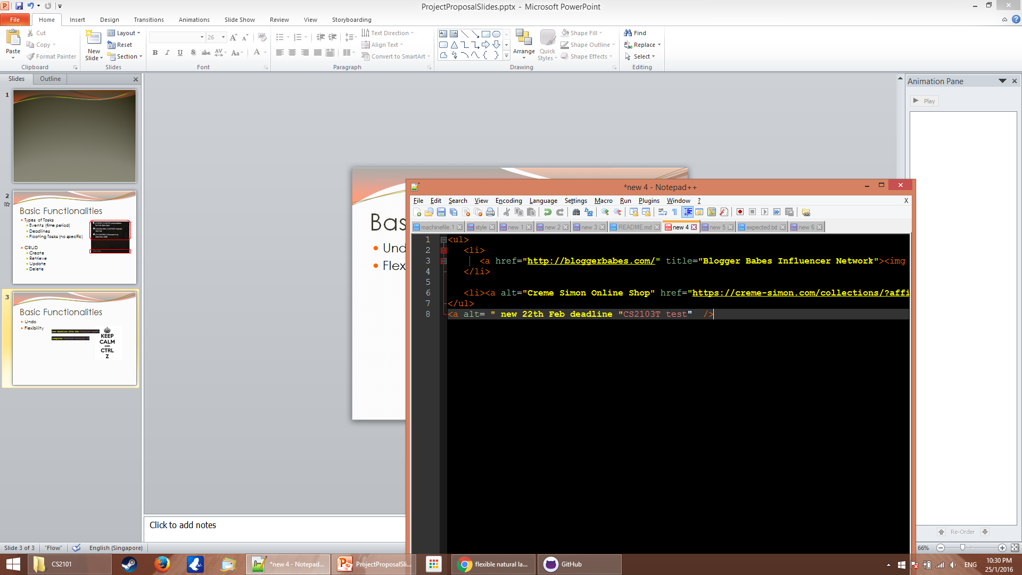


Basic Functionalities
Undo
Flexibility
Accessibility

Slide 4
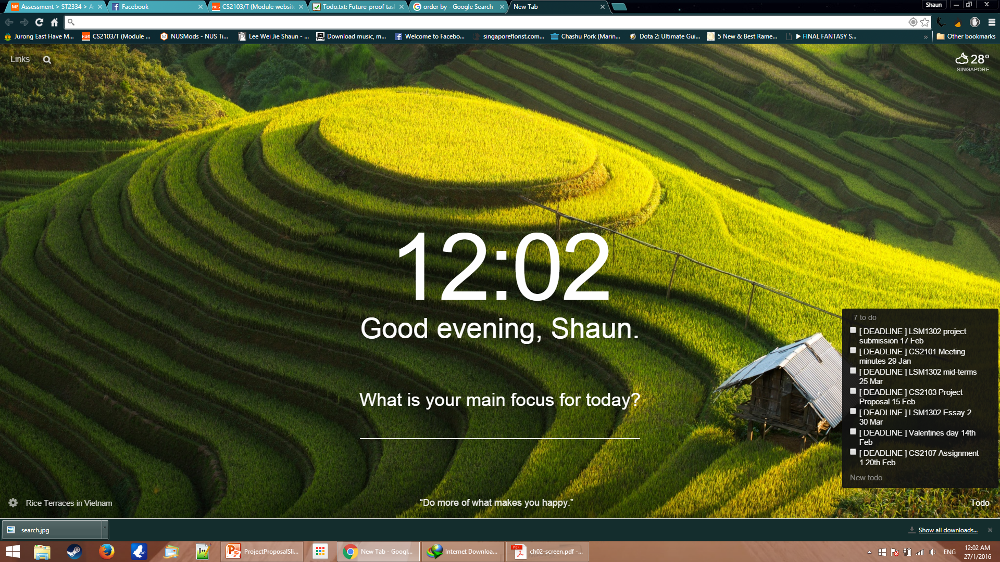

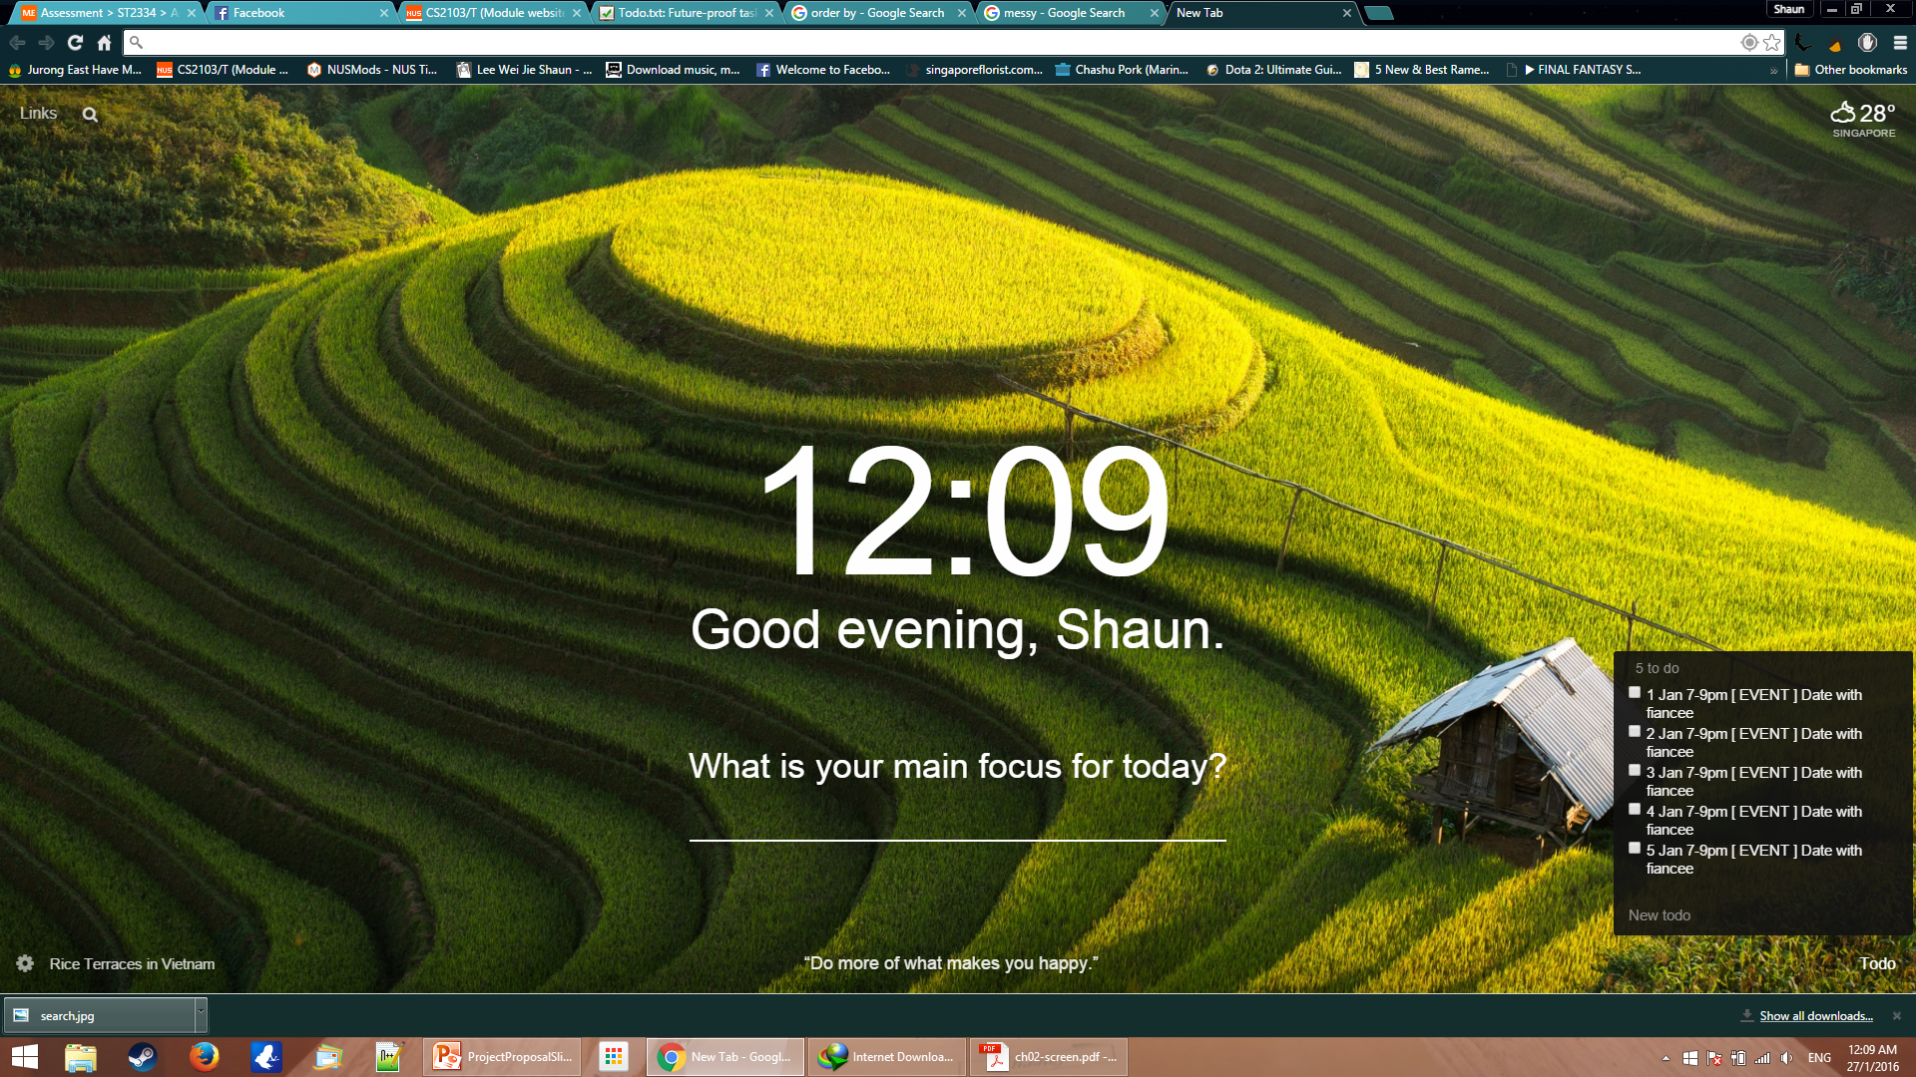
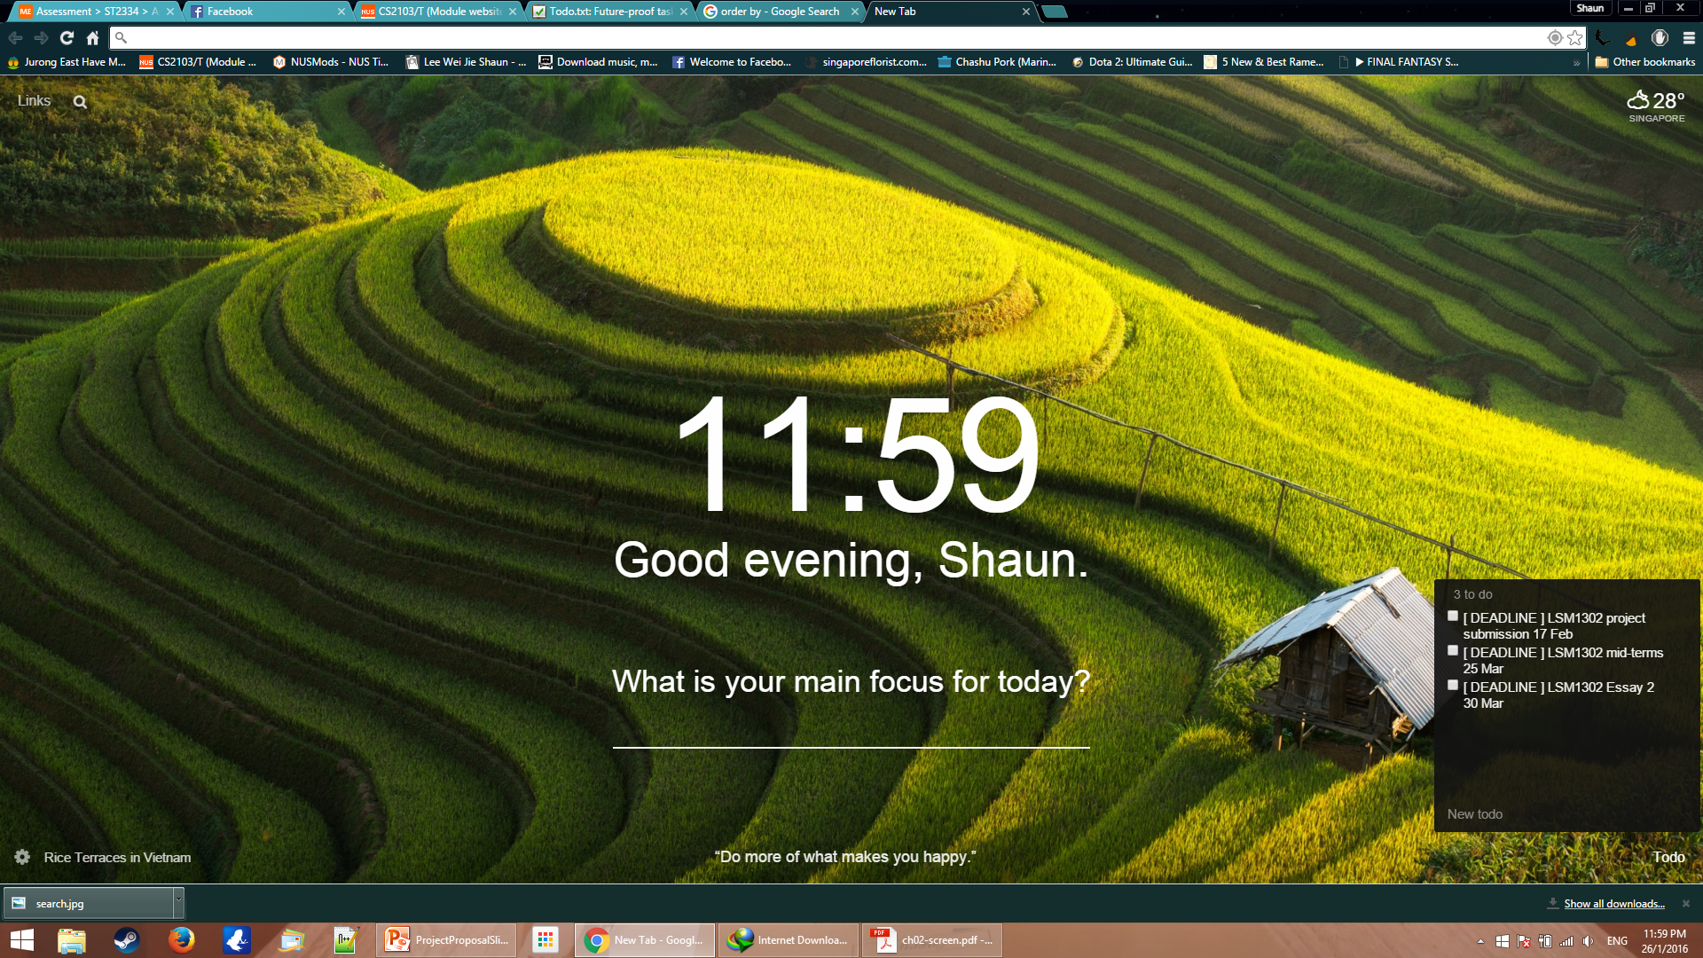
Basic Functionalities
Searching
Sorting
LSM1302

Slide 5
Extra Functionalities(basic)
Recurring tasks
add CS2103T meeting -rw 01256 -t 5pm
Weekly Recurring
Recurring period | Command
Every x days | -rd 4
Weekly (Sun-Sat: 0-6) | -rw 035
Monthly | -rm 21
Yearly | -ry 27.03

Slide 6
Extra Functionalities(basic)
Hot-key call out
Ctrl + Alt + Space

Slide 7
Extra Functionalities(basic)
Short-cut for keywords
add CS2103T meeting -t 15:00 -d 10.02.2016
All alias starts with underscore
add _3t _m –t 3pm –d 10

